Slide 1
The Impacts of the CCCTB Introduction on the Distribution of the Group Tax Bases across the EU: The Study for the Czech Republic
16th October 2011
Danuše Nerudová, Veronika Solilová

Slide 2
Aim
To quantify the differences in the division of the MNEs group tax bases between the individual Member States in current situation – i.e. when applying separate entity approach and situation when CCCTB will be introduced – i.e. applying the allocation formula for sharing the tax base.
empirical analysis is based on the data available from the Amadeus database
the project GA CR No. 13-21683S

Slide 3
Introduction
EC has worked on CCCTB for more than 10 years
CCCTB directive proposal on 16th March 2011
Fair tax competition
Elimination of TP problems
Decrease in compliance costs of taxation
Mechanism for sharing the tax base

Slide 4
Theoretical Background
Formulary apportionment vs separate accounting
(Musgrave, 1972) FA could eliminate problem with TP
(McLure, 1980) 3 factor formula transforms CIT into a tax on property, payroll and sales; also proved by (Golbsee, 2000; Maydew, 2000) or (Welish,2000)
Methods of sharing the tax base in EU context (Hellerstein, 2001; McLure, 2004)
(Weiner, 2005); (Mintz, 2004); (Sorensen, 2004)

Slide 5
Methodology
Data selection
- two tier test
- at least 50.01% ownership in the controlled company and
more than 75.01 % of the voting rights
- identification of CZ parent companies and subsidiaries in the EU
- comparative analysis of national consolidation and group taxation regimes (full consolidation, pooling, intra-group loss transfer and no scheme available)
- calculation of the division of the group tax bases among the EU Member States, where subsidiaries are situated

Slide 6
Methodology
Operating revenue – S
Cost pf employment – P
Employee headcount – E
Fixed Assets - A
- missing data imputed based on the observed data for companies in the same industry for Eastern and Western Europe (i.e. EU-13 and EU-15).

Slide 7
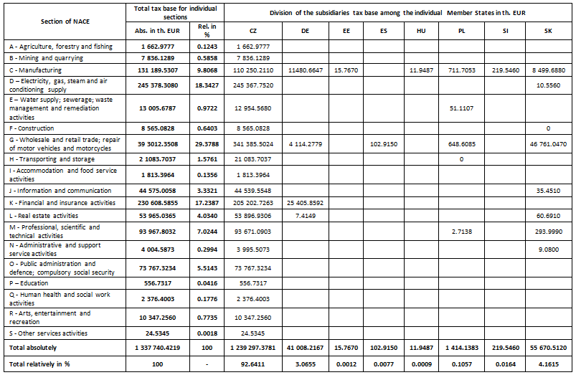
Conclusion

Slide 8
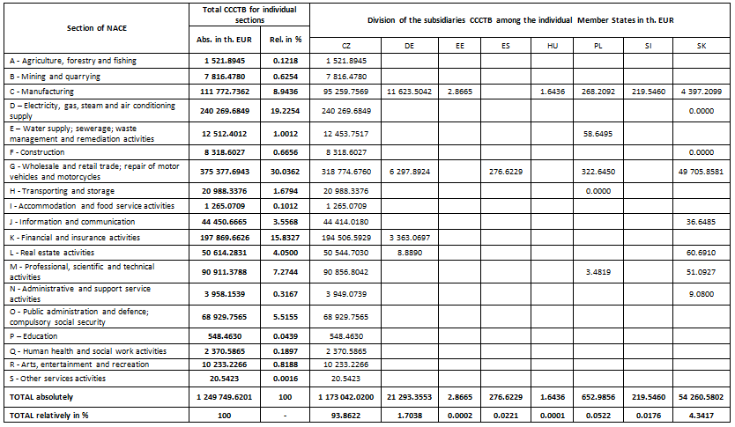
Conclusions

Slide 9
Conclusions
Increase by 1.22% for CZ
Increase by 1.18 %for SK
Increase by 0.05% for ES
Decrease by 1.36% for Germany
Decrease for EE, HU and Poland

Slide 10
Thank you for your attention !!
12th October 2011, Brno
Danuše Nerudová Department of Accounting and Taxes
danuse.nerudova@mendelu.cz www.mendelu.cz

